Slide 1

March 2019
CoLabora / SCUGDK

Slide 2
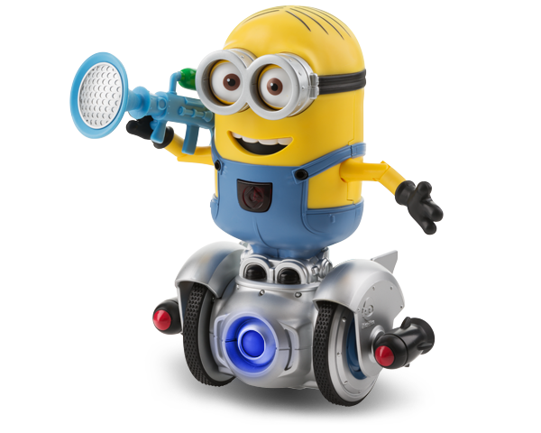
Agenda
09.00 Welcome 09.05 Don't get phished! 09.30 Unified Labling and Azure Information Protection 10.00 What’s new in Microsoft Intune, Marius Skovli 10.30 M365 explained from a Teams Perspective 11.00 Q and A

Slide 3
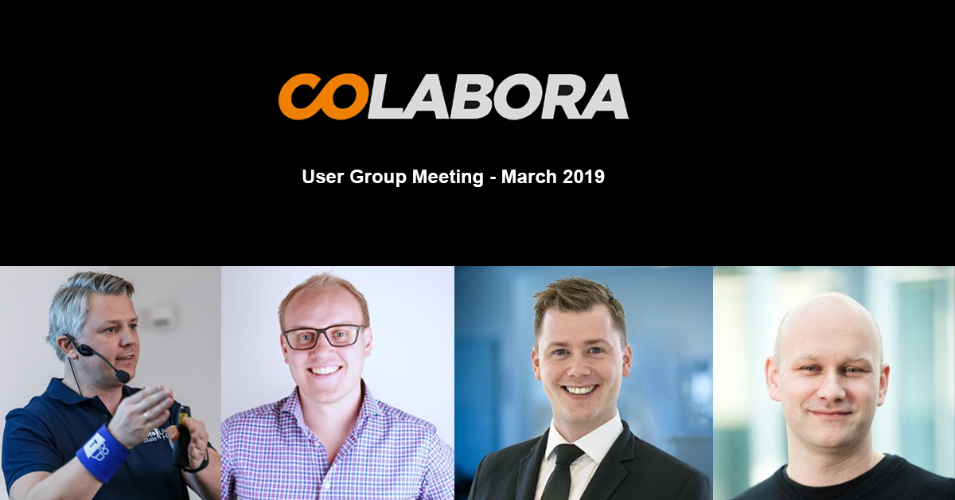
Welcome our speakers

Slide 4

CoLabora
The idea behind our user group
Community to share knowledge
Focus on Microsoft 365
Online events / meetups
Non profit organization
Upcoming Events
April 26, 2019
June 14, 2019
August 16, 2019
And… Sep, Oct, Nov, Dec
Other Events
Techorama BE (May)
ExpertsLive NO (May)
ExpertsLive NL (June)
Microsoft Ignite 2018 (September)

Slide 5
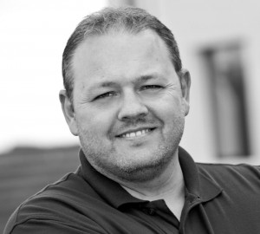

The Team Behind CoLabora
Ronni Pedersen
Cloud Architect
APENTO
Microsoft MVP: Enterprise Mobility
Microsoft Certified Trainer
Contact Me
Twitter: @ronnipedersen
Blog: https://www.ronnipedersen.com/
Mail: rop@apento.com
Phone: +45 2085 9452
Peter Schmidt
Cloud Architect
NeoConsulting
Microsoft MVP: Office Apps and Services
Microsoft Certified Master
Contact Me
Twitter: @petsch
Blog: https://www.msdigest.net/
Mail: peter@neoconsulting.dk
Phone: +45 2080 9436

Slide 6
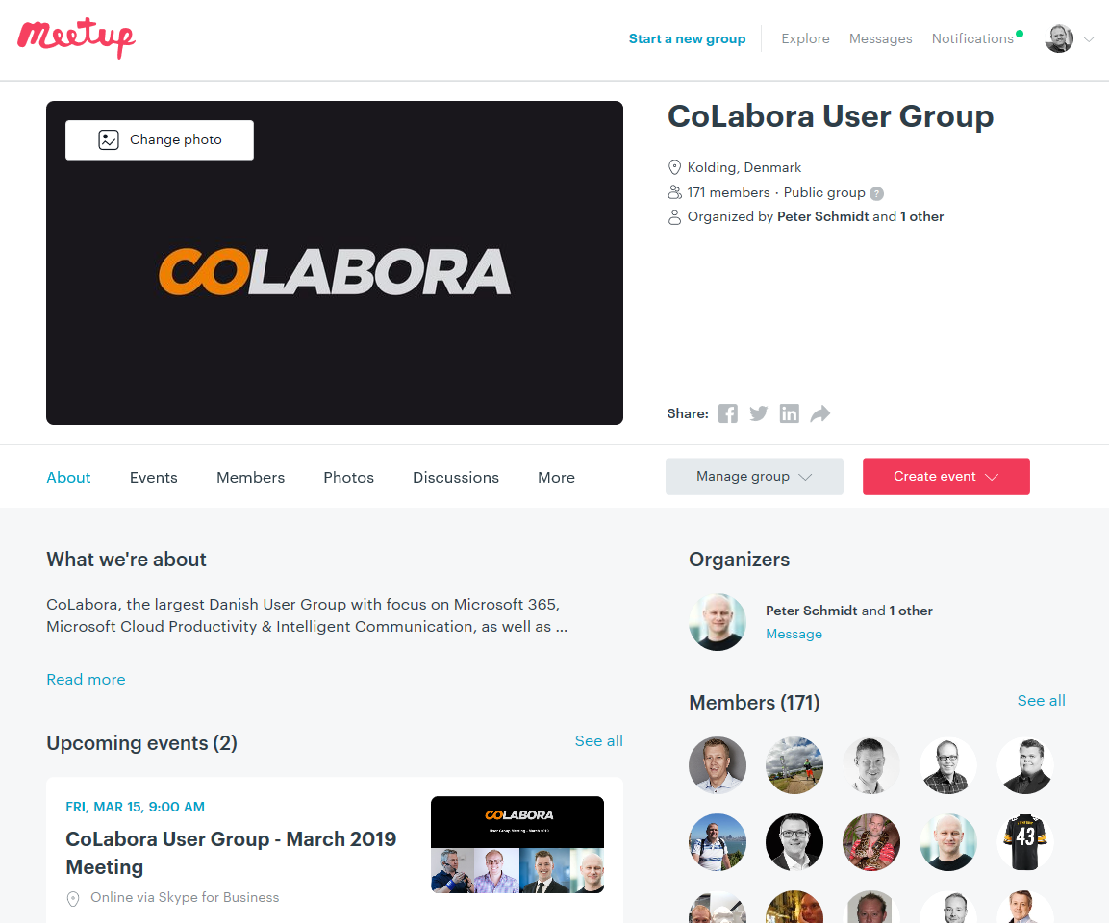
CoLabora@ Meetup.com

Slide 7
Join the Community
Join the conversation on the social media and use #CoLaboraDK

Slide 8
Our Sponsors
We’re still looking ☺

Slide 9
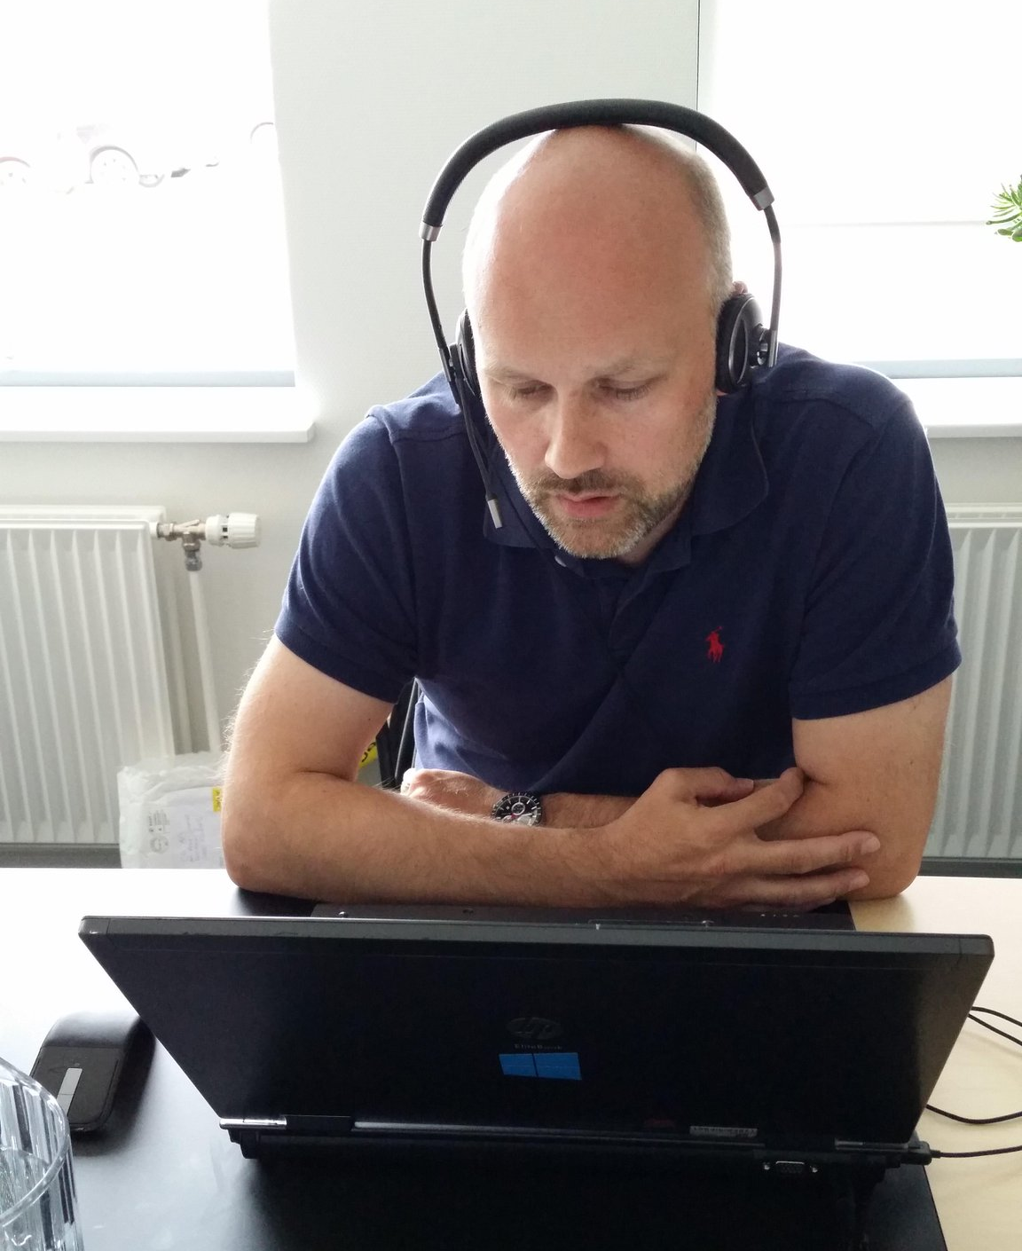
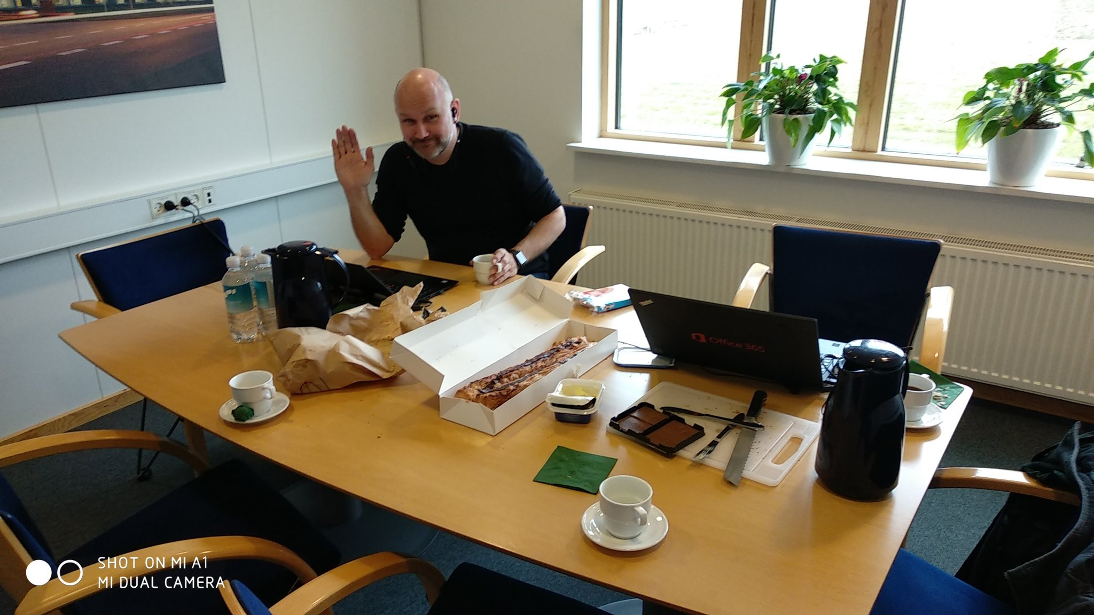
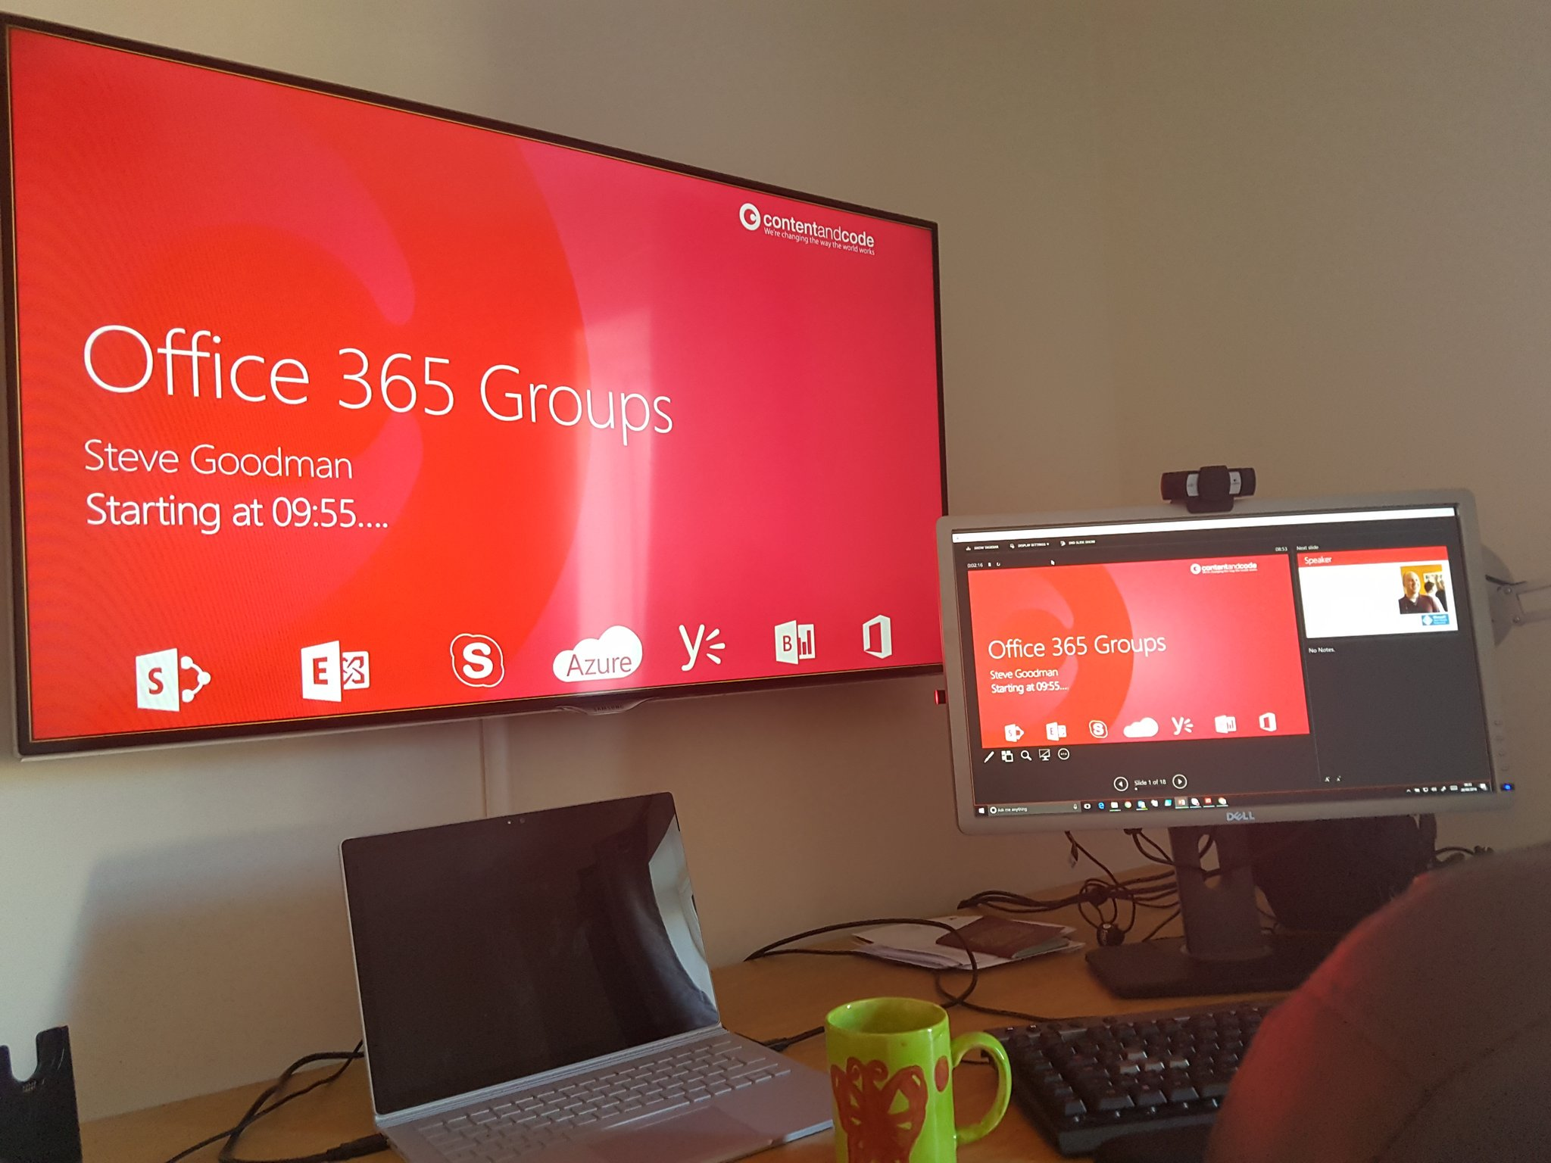
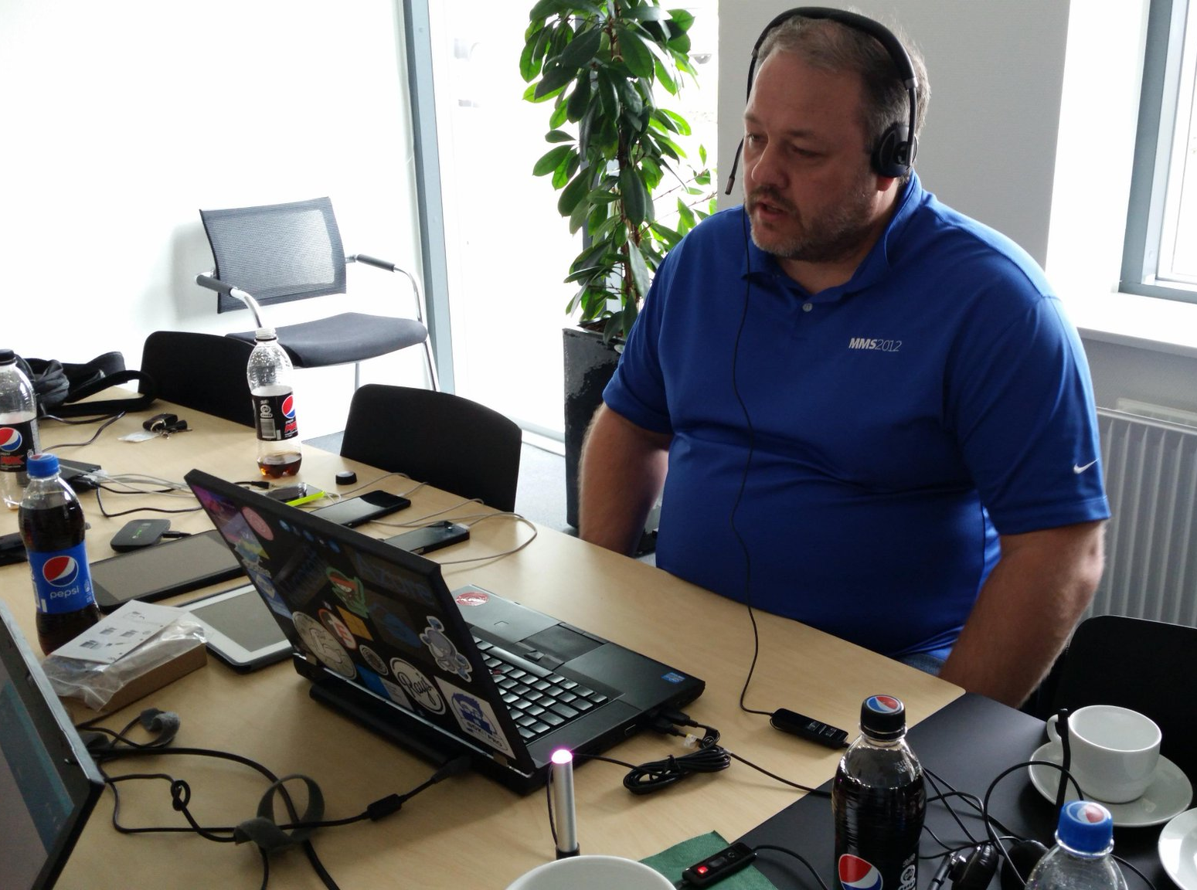
Our Sponsors
We’re still looking ☺

Slide 10

Let’s begin
Enjoy the day…

